Slide 1
Online Tools for Data Visualization
Based on “The 33 best tools for data visualization”

Slide 2
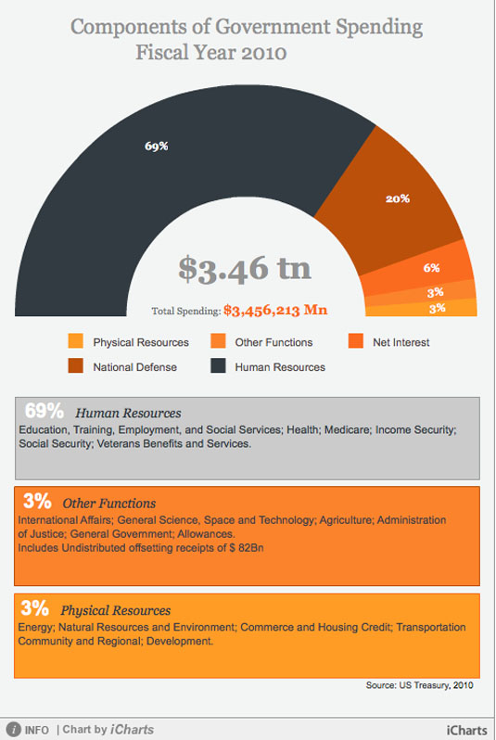
iCharts (Cloud based)

Slide 3
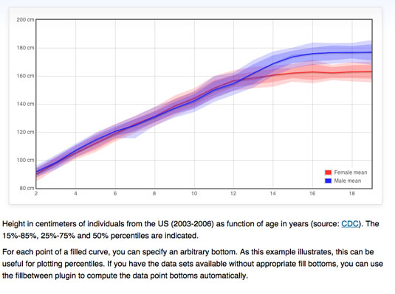
Flot (jQuery)

Slide 4
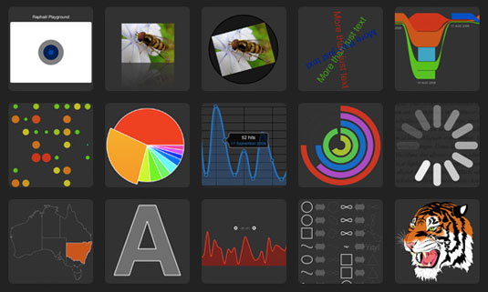
Raphaël (JavaScript library)

Slide 5
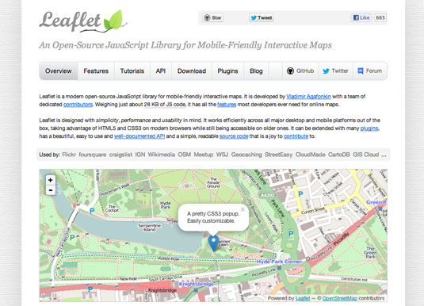
Leaflet (HTML5/CSS3)

Slide 6
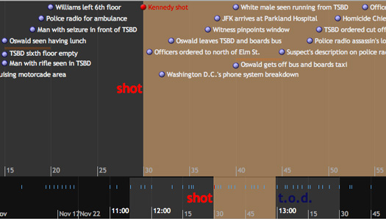
Timeline (Widget)

Slide 7
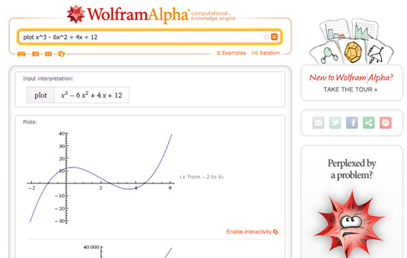
WolframAlpha (computational knowledge engine)

Slide 8
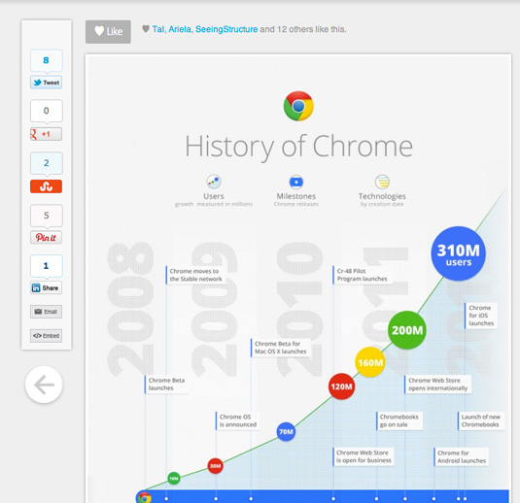
Visual.ly (infographic generation tool)

Slide 9
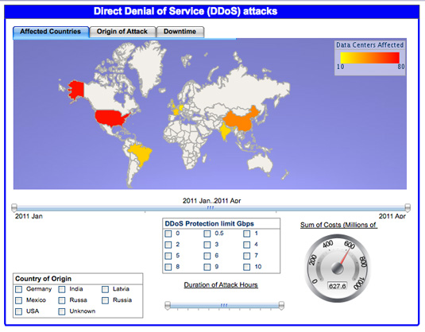
Visualize Free (hosted tool, HTML5)

Slide 10
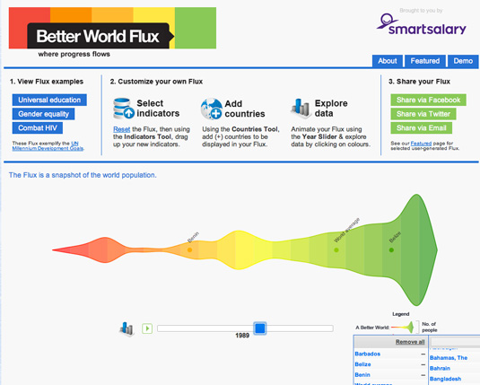
Better World Flux (Visualisation of Data sets)

Slide 11
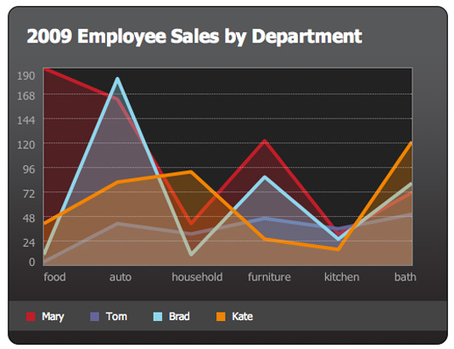
jQuery Visualize (jQuery plug-in, uses Canvas)

Slide 12
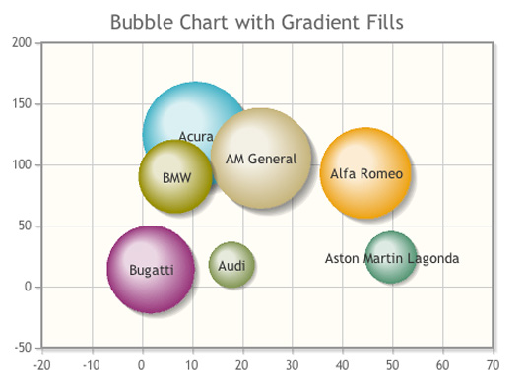
jqPlot (jQuery plug-in)

Slide 13
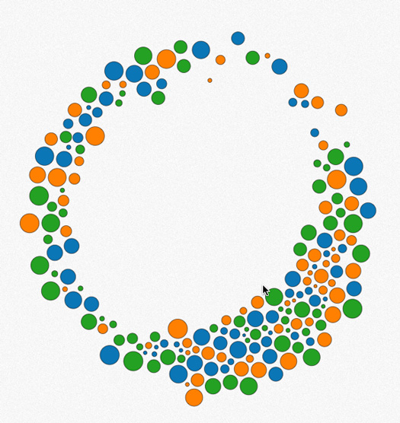
D3.js (JavaScript library)

Slide 14
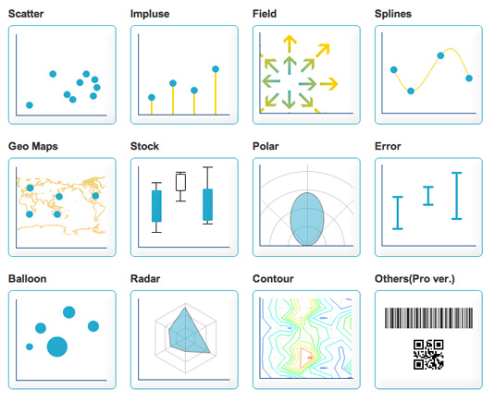
jpGraph (PHP server-side)

Slide 15
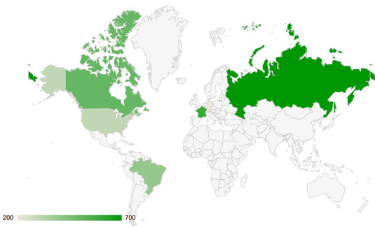
Google Charts

